Slide 1
Genetic algorithm in repeating prisoner dilemma
Wenhao

Slide 2
Background: Axelrod Experiment
Repeating prisoner dilemma: corporation is preferred
3 points for both corporate, 0 for corporate being betrayed, 5 points for betray vs. corporate, 1 point for both betray
Winning strategy: ‘tit for tat’
Simple strategy behaved better
Reference: Axelrod, R. (1980). Effective Choice in the Prisoner’s Dilemma. Journal of Conflict Resolution, 24(1), 3–25.

Slide 3
Background: John Holland genetic algorithm
Computer program that simulates evolution
Alternative approach to artificial intelligence
Mutation and independent assortment
Reference: Adaptation in Natural and Artificial Systems (1975, MIT Press)

Slide 4
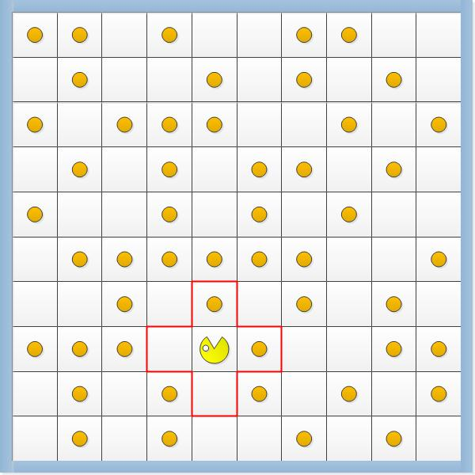
Background: John Holland genetic algorithm
Pac-man program: an example of genetic algorithm
Winning strategy: complex strategy that could not be simplified
Reference: Adaptation in Natural and Artificial Systems (1975, MIT Press)

Slide 5
Background
There is a contradiction between Axelrod’s experiment and John Holland’s experiment: The winning strategy is simple or complex

Slide 6
Hypothesis
Genetic algorithm can produce a complex strategy that could behave better than ‘tit for tat’ in Axelrod Experiment.

Slide 7
Program Development: equation for decision
In order to develop a genetic algorithm for Axelrod’s experiment, we need an equation that could simulate the decision-making process
Assumption for the equation:
Decision is solely based on three things: background knowledge + opponent’s previous moves + random event
These three things are independent of each other
(-100,100) + sum((-10,10)an) + (-10,10)random(-10,10)

Slide 8
Program Development: genetic algorithm
Mutation: insertion, substitution, deletion
Mutation: duplication
Independent assortment

Slide 9
Result Analysis:
Highest score for the genetic algorithm: 709.0909090909091
Score of ‘tit for tat’: 492.0

Slide 10
Result analysis
Maximum score not improving: likely due to limited number of variables in the genetic algorithm and the limited number of strategies envolved
Average score improving:

Slide 11
Result Analysis
Variable of background knowledge is relatively high
Which means that the strategy more likely to corporate
Random variables always weigh less than background knowledge
No significant trend was found in the variable for the opponent’s previous moves
BK | Random
100 | -9
93 | -5
84 | 4
95 | 6
56 | -2
94 | -3
88 | -6
90 | -7
62 | 2
77 | 6
94 | 5
52 | 4
75 | 6

Slide 12
Limitation: equation for decision
Decision is solely based on three things: background knowledge + opponent’s previous moves + random event
These three things are independent of each other

Slide 13
Limitation: Axelrod’s experiment
Only 11 preset strategies were defined
Competition is a fixed set of 200 rounds

Slide 14
Limitations: genetic algorithm
Duplication and Deletion

